Slide 1
Memory Management
In a uniprogramming system, main memory is divided into two parts:
One part for operating system.
One part for program currently being executed.
In a multiprogramming system, “user” part of memory is subdivided to accommodate multiple processes.
Task of subdivision is carried out dynamically by operating system and is known as memory management.

Slide 2
Objectives
To provide a detailed description of various ways of organizing memory hardware
To discuss various memory-management techniques, including paging and segmentation

Slide 3
Background
Program must be brought (from disk) into memory and placed within a process for it to be run
Main memory and registers are only storage CPU can access directly
Register access in one CPU clock (or less)
Main memory can take many cycles
Cache sits between main memory and CPU registers
Protection of memory required to ensure correct operation

Slide 4
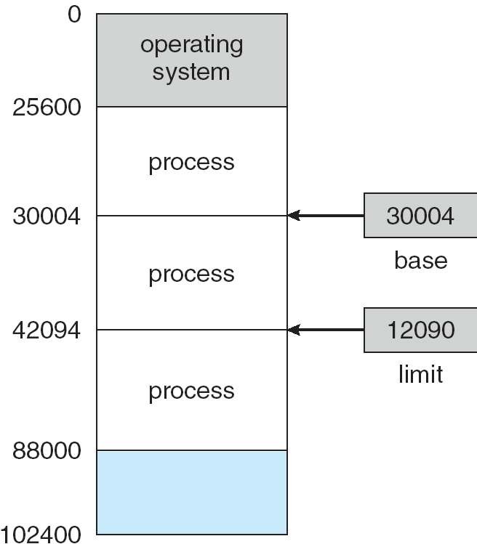
Base and Limit Registers
A pair of base and limit registers define the logical address space

Slide 5
Binding of Instructions and Data to Memory
Address binding of instructions and data to memory addresses can happen at three different stages
  Compile time: If memory location known a priori, absolute code can be generated; must recompile code if starting location changes
  Load time: Must generate relocatable code if memory location is not known at compile time
  Execution time: Binding delayed until run time if the process can be moved during its execution from one memory segment to another. Need hardware support for address maps (e.g., base and limit registers)

Slide 6
Logical vs. Physical Address Space
The concept of a logical address space that is bound to a separate physical address space is central to proper memory management
  Logical address – generated by the CPU; also referred to as virtual address
  Physical address – address seen by the memory unit
Logical and physical addresses are the same in compile-time and load-time address-binding schemes; logical (virtual) and physical addresses differ in execution-time address-binding scheme

Slide 7
Memory-Management Unit (MMU)
Hardware device that maps virtual to physical address
In MMU scheme, the value in the relocation register is added to every address generated by a user process at the time it is sent to memory
The user program deals with logical addresses; it never sees the real physical addresses

Slide 8
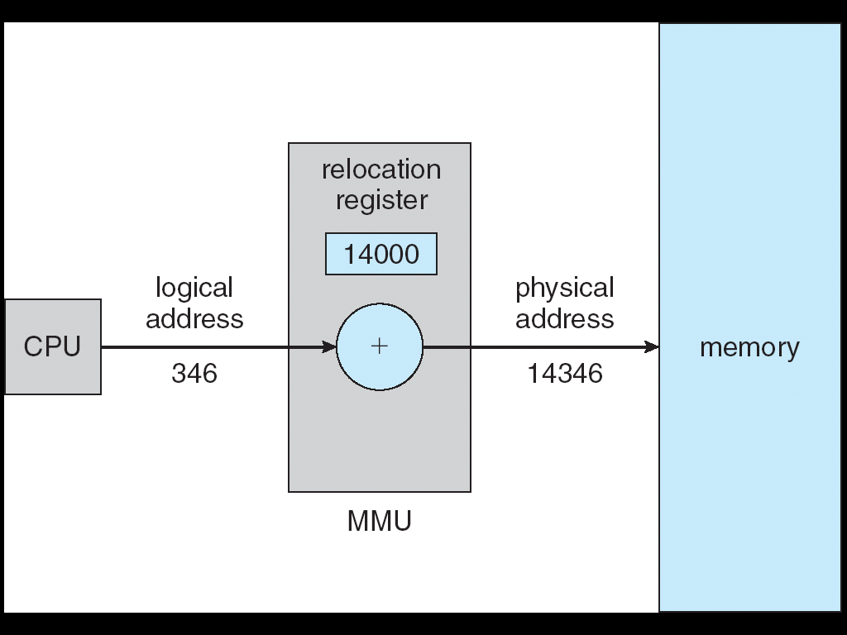
Dynamic relocation using a relocation register

Slide 9
Dynamic Loading
Routine is not loaded until it is called
Better memory-space utilization; unused routine is never loaded
Useful when large amounts of code are needed to handle infrequently occurring cases
No special support from the operating system is required implemented through program design

Slide 10
Swapping
A process can be swapped temporarily out of memory to a backing store, and then brought back into memory for continued execution
Backing store – fast disk large enough to accommodate copies of all memory images for all users; must provide direct access to these memory images
Roll out, roll in – swapping variant used for priority-based scheduling algorithms; lower-priority process is swapped out so higher-priority process can be loaded and executed
Major part of swap time is transfer time; total transfer time is directly proportional to the amount of memory swapped
Modified versions of swapping are found on many systems (i.e., UNIX, Linux, and Windows)
System maintains a ready queue of ready-to-run processes which have memory images on disk

Slide 11
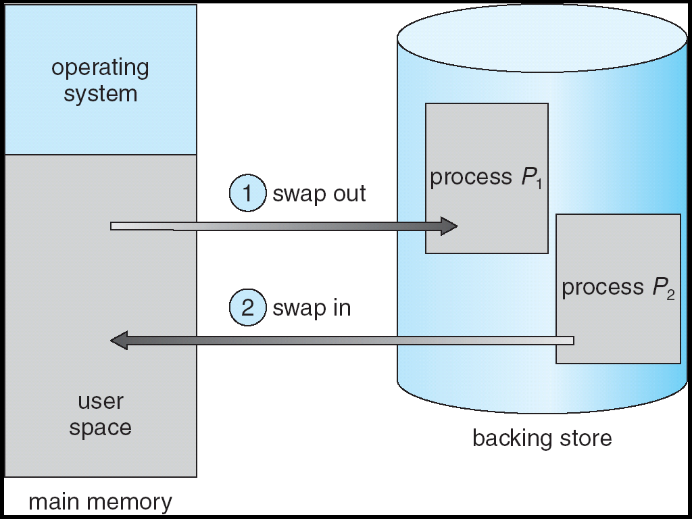
Schematic View of Swapping

Slide 12
Contiguous Allocation
Main memory usually into two partitions:
  Resident operating system, usually held in low memory with interrupt vector
  User processes then held in high memory
Relocation registers used to protect user processes from each other, and from changing operating-system code and data
  Base register contains value of smallest physical address
  Limit register contains range of logical addresses – each logical address must be less than the limit register
  MMU maps logical address dynamically

Slide 13
Dynamic Storage-Allocation Problem
How to satisfy a request of size n from a list of free holes
First-fit: Allocate the first hole that is big enough
Best-fit: Allocate the smallest hole that is big enough; must search entire list, unless ordered by size
  Produces the smallest leftover hole
Worst-fit: Allocate the largest hole; must also search entire list
  Produces the largest leftover hole
First-fit and best-fit better than worst-fit in terms of speed and storage utilization

Slide 14
Associative Memory
Associative memory – parallel search
Address translation (p, d)
  If p is in associative register, get frame # out
  Otherwise get frame # from page table in memory
Page #
Frame #

Slide 15
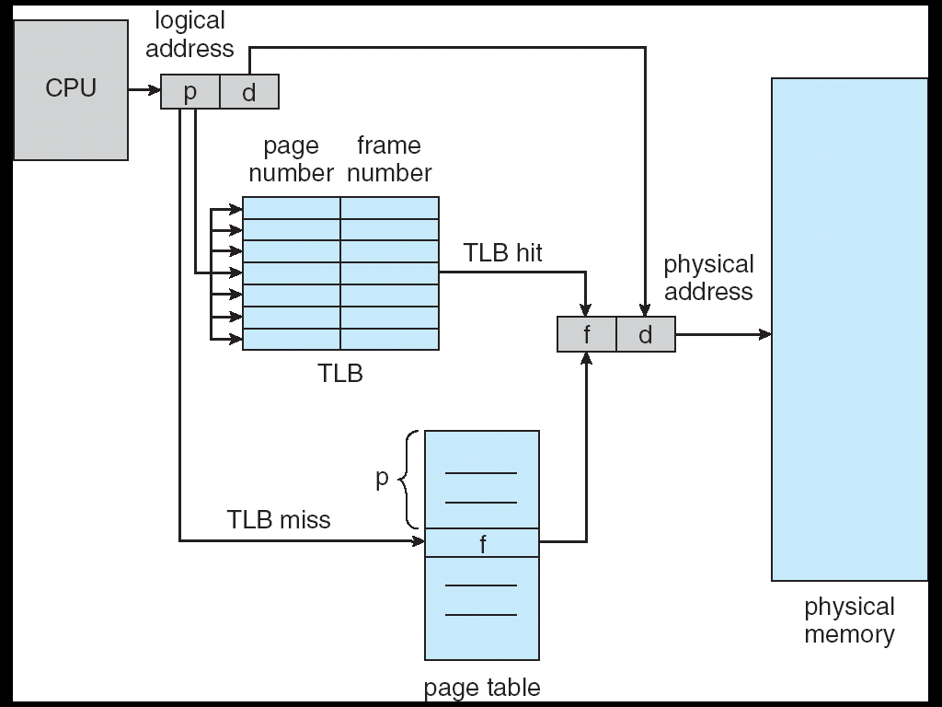
Paging Hardware With TLB

Slide 16
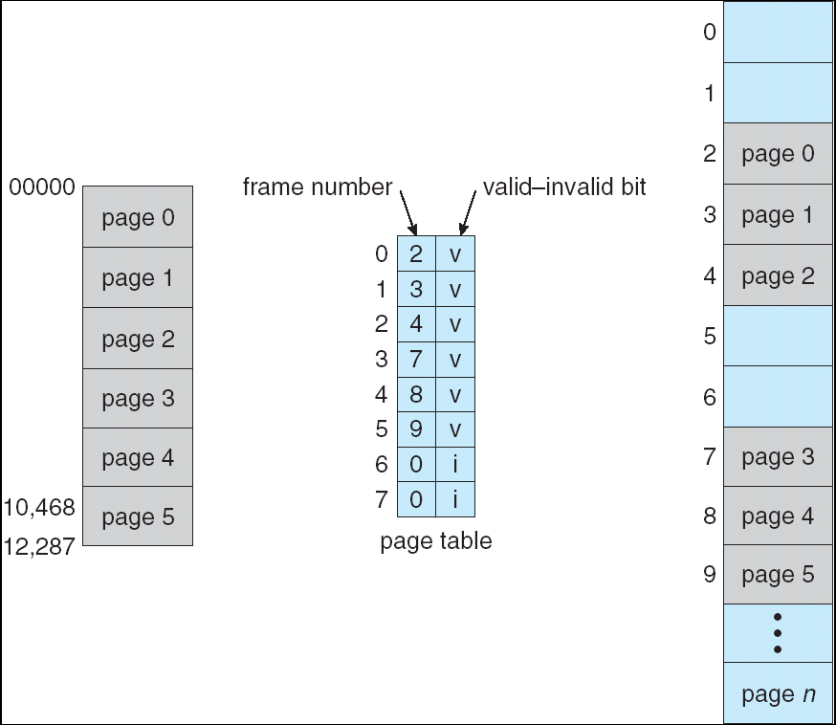
Valid (v) or Invalid (i) Bit In A Page Table

Slide 17
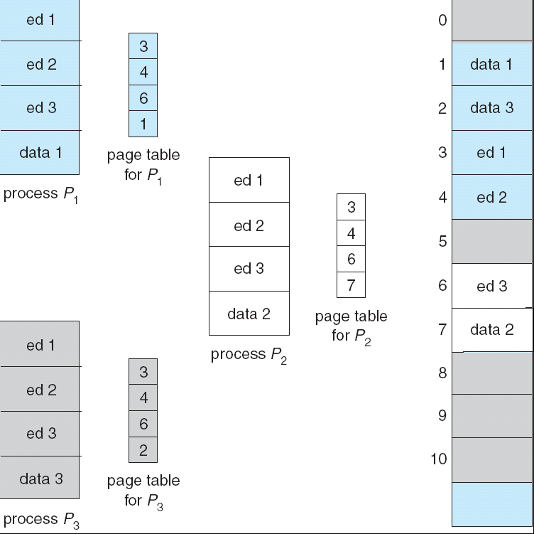
Shared Pages Example

Slide 18
Memory Management
Kernel
(OS)
Kernel
(OS)
Program
(user)
Program 1
Program 2
.
.
.
Program n
Uniprogramming
System
Multiprogramming
System

Slide 19
Memory Management
Problem: I/O is so slow compared with CPU that even in multiprogramming system, CPU can be idle most of time.
One solution is swapping
Is used when all processes currently in system become blocked waiting for I/O.
Some waiting processes are swapped out to an intermediate queue in disk storage.
Other processes (which have all resources they need) are admitted from long-term queue or swapped in from intermediate queue to keep processor busy.

Slide 20
Memory Management
Partitioning
Memory is partitioned among running processes.
  Operating system occupies a fixed portion of main memory.
  Remaining memory is partitioned among other processes.
    Fixed-size partitions. Different sized partitions are pre-set and processes are loaded into the smallest that will work.
    Variable-size partitions (Dynamic partitioning). A process is allocated exactly as much memory as it requires.

Slide 21
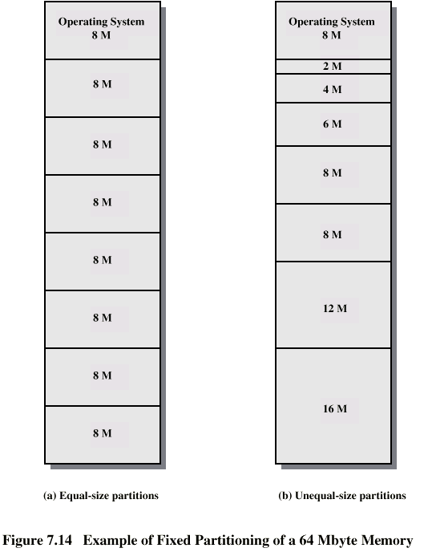
Memory Management
Example of fixed partitioning of a 64 Mbyte memory.

Slide 22
Memory Management
Fixed Partitioning
In this scheme, available memory is divided into fixed portions.
Main memory use is inefficient. Any program, no matter how small, occupies an entire partition. This is called internal fragmentation.

Slide 23
Memory Management
Fixed Partitioning – Equal-size partitions
Any process whose size is less than or equal to partition size can be loaded into an available partition.
If all partitions are full, operating system can swap a process out of a partition.
A program may not fit in a partition. Programmer must design program with overlays.

Slide 24
Memory Management
Fixed Partitioning Placement Algorithms
Equal-size partitions
10 M
Because all partitions are of equal size, it does not matter which partition is used.
Process
10 M
6 M
Internal
Fragmentation
6M

Slide 25
Memory Management
Fixed Partitioning Placement Algorithms
Unequal-size partitions
Can assign each process to smallest partition within which it will fit to minimize wasted memory within a partition.
Process
10 M
10 M
2 M
Internal
Fragmentation
2M

Slide 26
Memory Management
Variable-size Partitions (Dynamic Partitioning)
Partitions are of variable length and number.
Process is allocated exactly as much memory as required.
Eventually get holes in memory. This is called external fragmentation.

Slide 27
Memory Management
Variable-size Partitions (Dynamic Partitioning)
Assume 64 Mbytes of main memory is available for processes:
P1
20 M
P2
14 M
P3
18 M
P4
8 M

Slide 28
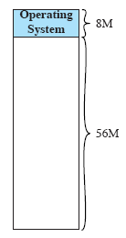
Memory Management
Variable-size Partitions (Dynamic Partitioning)
Initially, main memory is empty, expect for operating system.

Slide 29
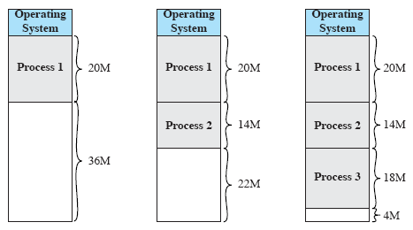
Memory Management
Variable-size Partitions (Dynamic Partitioning)
First three processes are loaded in, starting where operating system ends and occupying just enough space for each process.
This leaves a “hole” at end of memory that is too small for fourth process that needs 8 Mbytes.
P1
20 M
P2
14 M
P3
18 M
P4
8 M

Slide 30
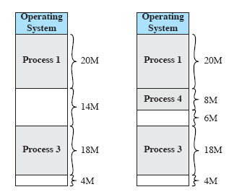
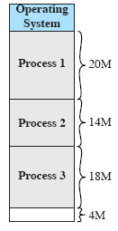
Memory Management
Variable-size Partitions (Dynamic Partitioning)
At some point, none of processes in memory is ready.
Operating system swaps out process 2, which leaves sufficient room to load a new process, process 4.
Because process 4 is smaller than process 2, another small hole is created.

Slide 31
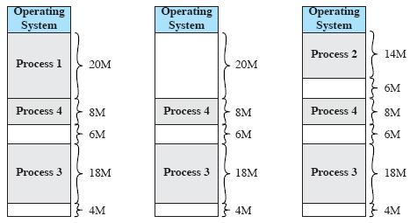
Memory Management
Variable-size Partitions (Dynamic Partitioning)
Later, a point is reached at which none of processes in main memory is ready, but process 2, in Ready-Suspended state, is available.
Because there is insufficient room in memory for process 2, operating system swaps process 1 out and swaps process 2 back in.

Slide 32
Memory Management
Variable-size Partitions (Dynamic Partitioning)
As seen in example, this method eventually leaves holes in memory. This is called external fragmentation.
One technique to overcome external fragmentation is compaction.
From time to time operating system shifts processes so they are contiguous and all free memory is together in one block.

Slide 33
Memory Management – Memory Compaction Process
Compaction will result in a block of free memory of length 16 Mbytes.
Difficulty with compaction is that it is a time consuming procedure and wasteful of processor time.

Slide 34
Memory Management – Memory Compaction Process
It is obvious that a process is not likely to be loaded into same place in main memory each time it is swapped in.
Furthermore, if compaction is used, a process may be shifted while in main memory.
A process in memory consists of instruction plus data.

Slide 35
Memory Management
Instructions will contain addresses for memory locations of two types:
Addresses of data items.
Addresses of instructions, used for branching instructions.
These addresses are not fixed.
They will change each time a process is swapped in.
To solve this problem, a distinction is made between logical addresses and physical addresses.
A logical address. Is expressed as a location relative to beginning of program.
A physical address. Is an actual location in main memory.
When processor executes a process, it automatically converts from logical to physical address by adding current starting location process called its base address, to each logical address.

Slide 36
Memory Management
Both unequal fixed-size and variable-size positions are inefficient in use of memory.
Paging
Extends partition idea by dividing up both memory and processes into equal size pieces.
  Pieces of memory are called frames.
  Pieces of a process are called pages.
Each process has a list of frames that it is using, called a page table, stored in process control block.
Operating system maintains a list of free frames that it can assign to new processes.

Slide 37
Memory Management
Use of pages and frames:
At a given point in time, some of frames in memory are in use and some are free.
Process A, stored on disk, consists of 4 pages.
When it comes time to load this process, OS finds 4 frames and loads 4 pages of process A into 4 frames.

Slide 38
Memory Management
If there are not sufficient unused neighbouring frames to hold process, does this prevent operating system from loading process?
Answer is no, because we can use concept of logical address.
A simple base address will no longer suffice.
Operating system maintains a page table for each process.
Page table shows frame location for each page of process.
Each logical address consists of a page number and a relative address within page.

Slide 39
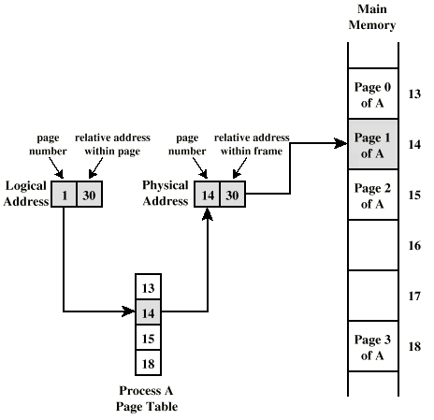
Memory Management

Slide 40
Memory Management - Segmentation
Another way in which addressable memory can be subdivided is segmentation.
Segmentation allows programmer to view memory as multiple address spaces or segments.
  Segmentation is transparent to programmer.
  Advantages
    It simplifies handling of growing data structures. OS will expand or shrink segment as needed.
    It lends itself to sharing among processes.
    It lends itself to protection. Programmer or system administrator can assign access privileges to a segment.

Slide 41
Fragmentation
External Fragmentation – total memory space exists to satisfy a request, but it is not contiguous
Internal Fragmentation – allocated memory may be slightly larger than requested memory; this size difference is memory internal to a partition, but not being used
Reduce external fragmentation by compaction
  Shuffle memory contents to place all free memory together in one large block
  Compaction is possible only if relocation is dynamic, and is done at execution time
  I/O problem
    Latch job in memory while it is involved in I/O
    Do I/O only into OS buffers

Slide 42
Paging
Logical address space of a process can be noncontiguous; process is allocated physical memory whenever the latter is available
Divide physical memory into fixed-sized blocks called frames (size is power of 2, between 512 bytes and 8,192 bytes)
Divide logical memory into blocks of same size called pages
Keep track of all free frames
To run a program of size n pages, need to find n free frames and load program
Set up a page table to translate logical to physical addresses
Internal fragmentation

Slide 43
Shared Pages
Shared code
  One copy of read-only (reentrant) code shared among processes (i.e., text editors, compilers, window systems).
  Shared code must appear in same location in the logical address space of all processes
Private code and data
  Each process keeps a separate copy of the code and data
  The pages for the private code and data can appear anywhere in the logical address space

